Slide 1
EC3357:Machine Learning
Lecture 1: Introduction to Machine Learning

Slide 2
What is Learning?
Herbert Simon: “Learning is any process by which a system improves performance from experience.”
“A computer program is said to learn from experience E with respect to some class of tasks T and performance measure P, if its performance at tasks in T, as measured by P, improves with experience E.” – Tom Mitchell
From the definition by Tom Mitchell (1998):
Machine Learning is the study of algorithms that
• improve their performance P
• at some task T
• with experience E.
A well-defined learning task is given by <P, T, E>.

Slide 4
How can we solve a specific problem?
As computer scientists we write a program that encodes a set of rules that are useful to solve the problem
In many cases is very difficult to specify those rules, e.g., given a picture determine whether there is a cat in the image.

Slide 5
Learning
Learning systems are not directly programmed to solve a problem, instead develop own program based on:
Examples of how they should behave
From trial-and-error experience trying to solve the problem
Learning simply means incorporating information from the training(input-output pairs) examples into the system

Slide 6
A classic example of a task that requires machine learning
It is very hard to say what makes a 2

Slide 7
Why use learning?
It is very hard to write programs that solve problems like recognizing a handwritten digit
What distinguishes a 2 from a 7?
How does our brain do it?
Instead of writing a program by hand, we collect examples that specify the correct output for a given input
A machine learning algorithm then takes these examples and produces a program that does the job

Slide 8
When Do We Use Machine Learning
ML is used when:
Human expertise does not exist (navigating on Mars)
• Humans can’t explain their expertise (speech recognition)
• Models must be customized (personalized medicine)
• Models are based on huge amounts of data (genomics)
Learning isn’t always useful:
• There is no need to “learn” to calculate payroll

Slide 9
More examples of tasks that are best solved by using a learning algorithm
Recognizing patterns:
– Facial identities or facial expressions
– Handwritten or spoken words
– Medical images
• Generating patterns:
– Generating images or motion sequences
• Recognizing anomalies:
– Unusual credit card transactions
– Unusual patterns of sensor readings in a nuclear power plant
• Prediction:
– Future stock prices or currency exchange rates

Slide 10
Sample Applications
Web search
• Computational biology
• Finance
• E-commerce
• Space exploration
• Robotics
• Information extraction
• Social networks
• Debugging software
• [Your favorite area]

Slide 11
Samuel’s Checkers-Player
“Machine Learning: Field of study that gives computers the ability to learn without being explicitly programmed.” -Arthur Samuel (1959)

Slide 12
Defining the Learning Task
Improve on task T, with respect to performance metric P, based on experience E
T: Playing checkers
P: Percentage of games won against an arbitrary opponent
E: Playing practice games against itself
T: Recognizing hand-written words
P: Percentage of words correctly classified
E: Database of human-labeled images of handwritten words
T: Driving on four-lane highways using vision sensors
P: Average distance traveled before a human-judged error
E: A sequence of images and steering commands recorded while observing a human driver.
T: Categorize email messages as spam or legitimate.
P: Percentage of email messages correctly classified.
E: Database of emails, some with human-given labels

Slide 13
Autonomous Driving

Slide 14
Flying Robots

Slide 15
Types of Learning
Supervised (inductive) learning
– Given: training data + desired outputs (labels)
Unsupervised learning
– Given: training data (without desired outputs)
• Semi-supervised learning
– Given: training data + a few desired outputs
• Reinforcement learning
– Rewards from sequence of actions. An agent interacting with the world makes observations, takes actions, and is rewarded or punished; it should learn to choose actions in such a way as to obtain a lot of reward.

Slide 16
ML taxonomy
Machine learning
Supervised
Semi-supervised
Unsupervised
Reinforcement learning
Regression
Classification
Clustering
Associations

Slide 17
Supervised Learning
Learning a discrete function: Classification
Boolean classification:
Each example is classified as true(positive) or false(negative).
predict categorical values, i.e., labels
Learning a continuous function: Regression
predict numerical values

Slide 18
Supervised learning
In supervised learning, the algorithms are presented with a set of classified instances from which they learn a way of classifying unseen instances. When the attribute to be predicted is numeric rather than nominal it is called regression.
Training data
Algorithm
Model
prediction

Slide 19
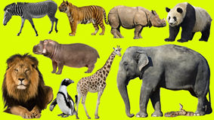

Classification
zebra
tiger
rhino
Algorithm
Model
panda
lion
hippo
elephant
lion
penguin
giraffe
snake

Slide 20
Classification—A Two-Step Process
Model construction: describing a set of predetermined classes
Each tuple/sample is assumed to belong to a predefined class, as determined by the class label
The set of tuples used for model construction is training set
The model is represented as classification rules, decision trees, or mathematical formulae
Model usage: for classifying future or unknown objects
Estimate accuracy of the model
The known label of test sample is compared with the classified result from the model
Test set is independent of training set, otherwise over-fitting will occur
If the accuracy is acceptable, use the model to classify data tuples whose class labels are not known
Notes:
20

Slide 21
Illustrating Classification Task

Slide 22
Issues: Data Preparation
Data cleaning
Preprocess data in order to reduce noise and handle missing values
Relevance analysis (feature selection)
Remove the irrelevant or redundant attributes
Data transformation
Generalize data to (higher concepts, discretization)
Normalize attribute values
Notes:
22

Slide 23
Classification Techniques
Decision Tree based Methods
Rule-based Methods
Naïve Bayes and Bayesian Belief Networks
Neural Networks
Support Vector Machines
and more...

Slide 24
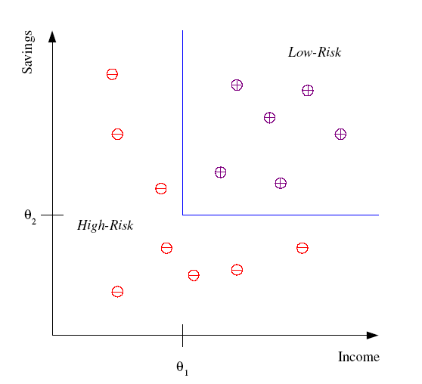
Classification
Example: Credit scoring
Differentiating between low-risk and high-risk customers from their income and savings
Discriminant: IF income > θ₁ AND savings > θ₂
THEN low-risk ELSE high-risk

Slide 25
Classification: Applications
Aka Pattern recognition
Face recognition: Pose, lighting, occlusion (glasses, beard), make-up, hair style
Character recognition: Different handwriting styles.
Speech recognition: Temporal dependency.
Use of a dictionary or the syntax of the language.
Sensor fusion: Combine multiple modalities; eg, visual (lip image) and acoustic for speech
Medical diagnosis: From symptoms to illnesses
...

Slide 26








Face Recognition
Training examples of a person
Test images

Slide 27
Supervised Learning: Regression

Slide 28
Supervised Learning: Uses
Prediction of future cases: Use the rule to predict the output for future inputs
Knowledge extraction: The rule is easy to understand
Compression: The rule is simpler than the data it explains
Outlier detection: Exceptions that are not covered by the rule, e.g., fraud

Slide 29
Unsupervised Learning: Overview
So far, in all the learning techniques we considered, a training example consisted of a set of attributes (or features) and either a class (in the case of classification) or a real number (in the case of regression) attached to it.
Unsupervised Learning takes as training examples the set of attributes/features alone.
The purpose of unsupervised learning is to attempt to find natural partitions in the training set.
Two general strategies for Unsupervised learning include: Clustering and Hierarchical Clustering.

Slide 30
Clustering and Hierarchical Clustering
Clustering Hierarchical Clustering
E
E
E1 E2
E7
E3
E8
E2
E4
E7 E8
E1

Slide 31
Other Unsupervised Methods:
There are a lot of other Unsupervised Learning Methods.
Examples:
k-means
The EM Algorithm
Competitive Learning
Kohonen’s Neural Networks: Self-Organizing Maps
Principal Component Analysis, Autoassociation

Slide 32
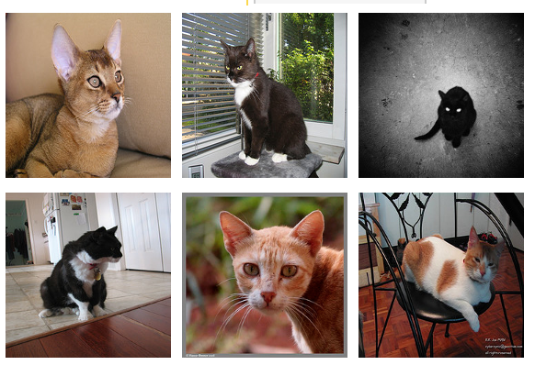
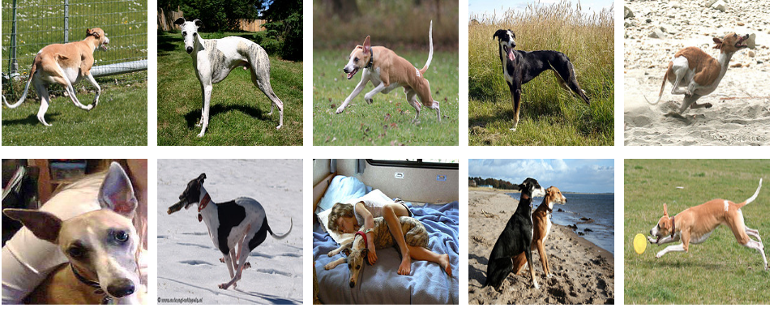
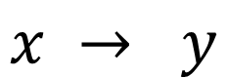
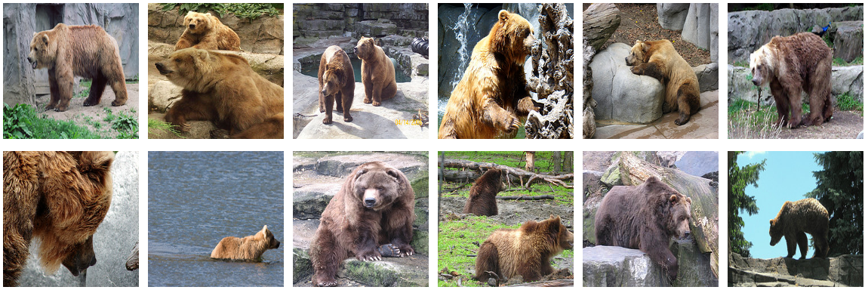
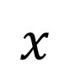
Supervised Learning vs Unsupervised Learning
$$x → y$$
$$x$$
cat
dog
bear
dog
bear
dog
cat
cat
bear

Slide 33
Supervised Learning vs Unsupervised Learning
$$x → y$$
$$x$$
cat
dog
bear
dog
bear
dog
cat
cat
bear

Slide 34
Supervised Learning vs Unsupervised Learning
$$x → y$$
$$x$$
cat
dog
bear
Classification
dog
Clustering
bear
dog
cat
cat
bear

Slide 35
Reinforcement Learning
Given a sequence of states and actions with (delayed) rewards, output a policy
– Policy is a mapping from statesàactions that tells you what to do in a given state
Examples:
– Credit assignment problem
– Game playing
– Robot in a maze
– Balance a pole on your hand

Slide 36
Reinforcement Learning

Slide 37
Designing a Learning System
Choose the training experience
Choose exactly what is to be learned
– i.e. the target function
Choose how to represent the target function
Choose a learning algorithm to infer the target function from the experience

Slide 38
Case Study
What grade will I get in this course?
Data: entry survey and marks from this and previous years
Process the data
Split into training set; and test set
Determine representation of input;
Determine the representation of the output;
Choose form of model: linear regression
Decide how to evaluate the system's performance: objective function
Set model parameters to optimize performance
Evaluate on test set: generalization

Slide 39
ML in a Nutshell
Tens of thousands of machine learning algorithms
– Hundreds new every year
Every ML algorithm has three components:
– Representation
– Optimization
– Evaluation

Slide 40
Various Function Representations
• Numerical functions
– Linear regression
– Neural networks
– Support vector machines
Symbolic functions
– Decision trees
– Rules in propositional logic
– Rules in first-order predicate logic
Instance-based functions
– Nearest-neighbor
– Case-based
Probabilistic Graphical Models
– Naïve Bayes
– Bayesian networks
– Hidden-Markov Models (HMMs)
– Probabilistic Context Free Grammars (PCFGs)
– Markov networks

Slide 41
Various Search/Optimization Algorithms
Gradient descent
– Perceptron
– Backpropagation
Dynamic Programming
– HMM Learning
– PCFG Learning
Divide and Conquer
– Decision tree induction
– Rule learning
• Evolutionary Computation
– Genetic Algorithms (GAs)
– Genetic Programming (GP)
– Neuro-evolution

Slide 42
Evaluation
Accuracy
Precision and recall
Squared error
Likelihood
Posterior probability
Cost / Utility
Margin
Entropy
K-L divergence
etc.

Slide 43
ML in Practice
Understand domain, prior knowledge, and goals
Data integration, selection, cleaning, pre-processing, etc.
Learn models
Interpret results
Consolidate and deploy discovered knowledge

Slide 44
Lessons Learned about Learning
Learning can be viewed as using direct or indirect experience to approximate a chosen target function.
Function approximation can be viewed as a search through a space of hypotheses (representations of functions) for one that best fits a set of training data.
Different learning methods assume different hypothesis spaces (representation languages) and/or employ different search techniques

